Slide 1




E-learning data analysis project
DONE BY
Engy Mohamed Nagy Beshoy Ayad
Michael Nabil Saed Serry
2024

Slide 2


e

Slide 3
AGENDA
01
03
02
04
Result and discussion
Overview
Objective
Introduction
Data Collection
Data analysis
Data visualization
Conclusion
Methodology

Slide 4

Project Goal
Enhancing E-learning in Egypt
‘How to improve E-learning in Egypt “

Slide 5
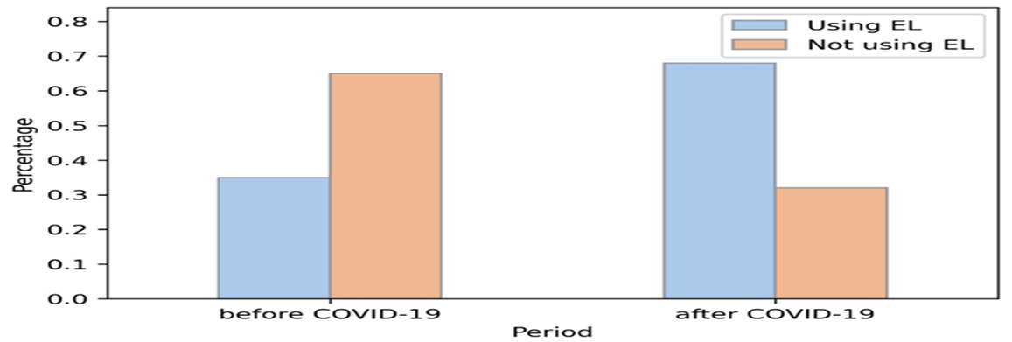

Project overview
E-Learning in Egypt has grown rapidly in response to covid-19 pandemic.
However ,it faces several challenges including low adoption of modern teaching technologies .

Slide 6

objective This project aims to address these issues and improve the overall E-learning experience for students , educators and institutions in Egypt.

Slide 7

Objective
To modernize Egypt education system through strategic improvement
in E-learning.
For future ready education system in Egypt.

Slide 8


Objective
Invest in and support services
such as tutoring and disability
support to address the diverse
needs of students.
Sustainable e-learning practices that can be integrated into traditional education models.

Slide 9

Data collection and resources
Methodology
http://analyse.kmi.open.ac.uk/open-dataset#description

Slide 10
Analysis plan
Data cleaning
Data preprocessing
Data visualization
Conclusion of analysis
python
SQL and python
Tableau &EXCEL

Slide 11
Methodology
No duplicates
Replace null values
Data cleaning
Dropping irrelevant data
Check outliers

Slide 12
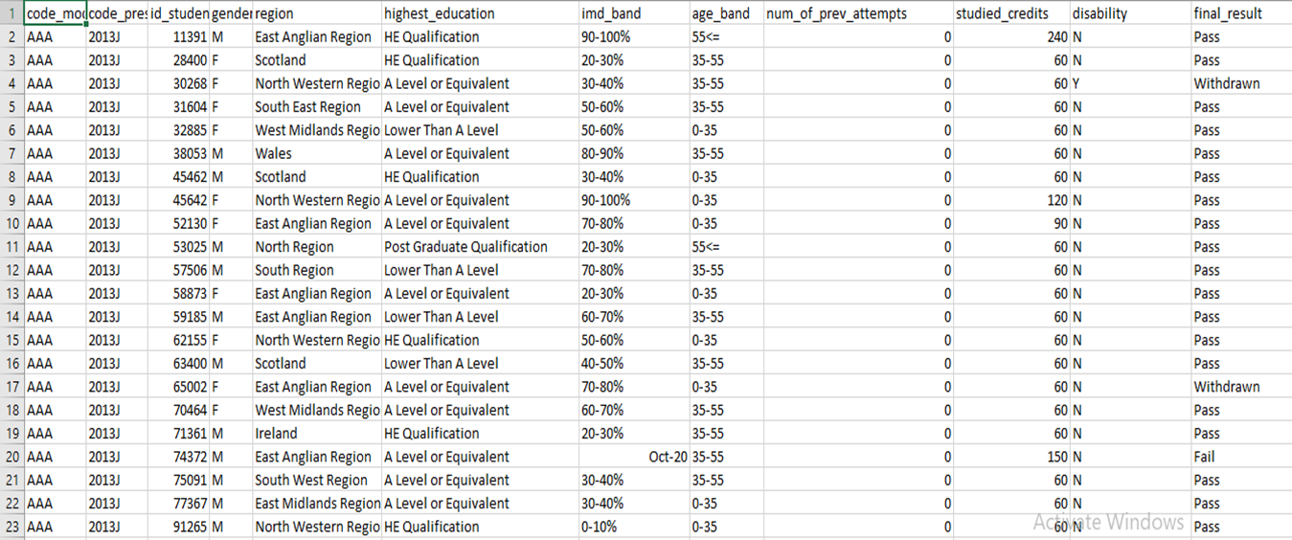
Data

Slide 13
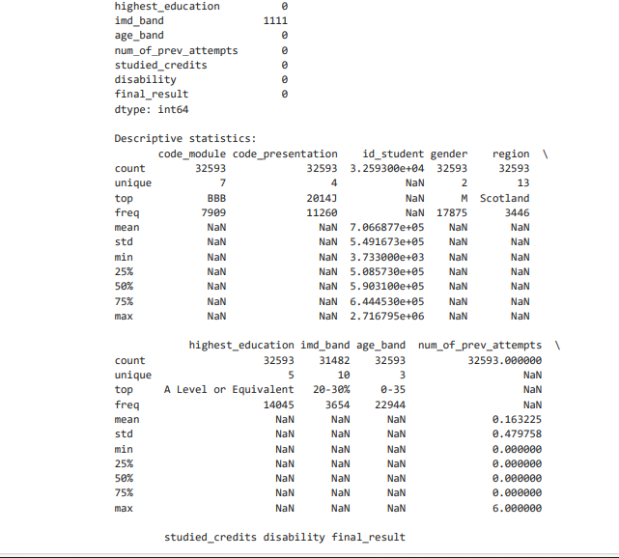
Data cleaning

Slide 14
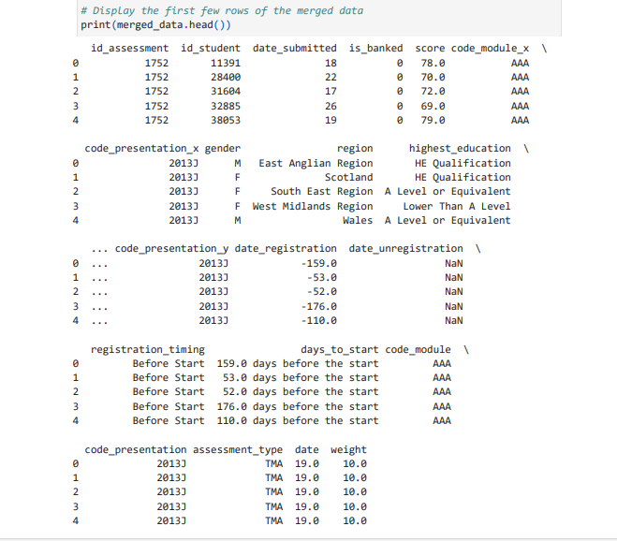

Slide 15
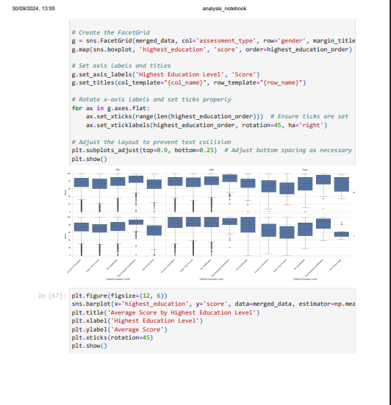
Data pre processing

Slide 16
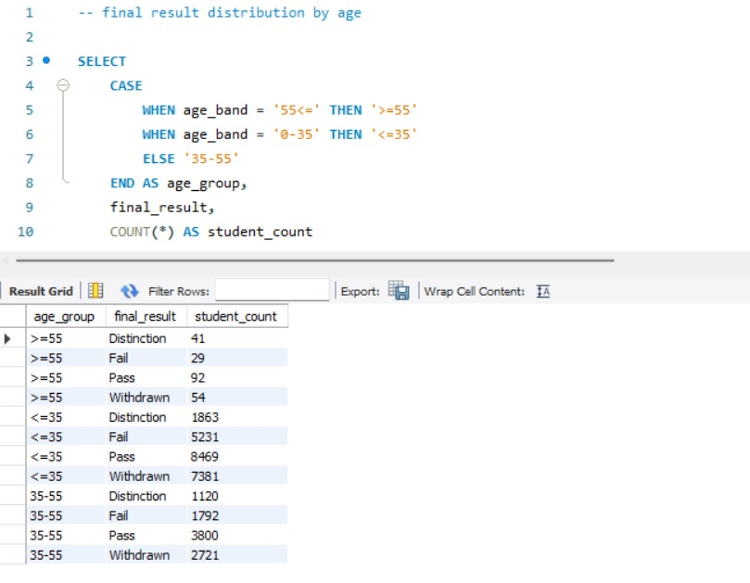


Slide 17
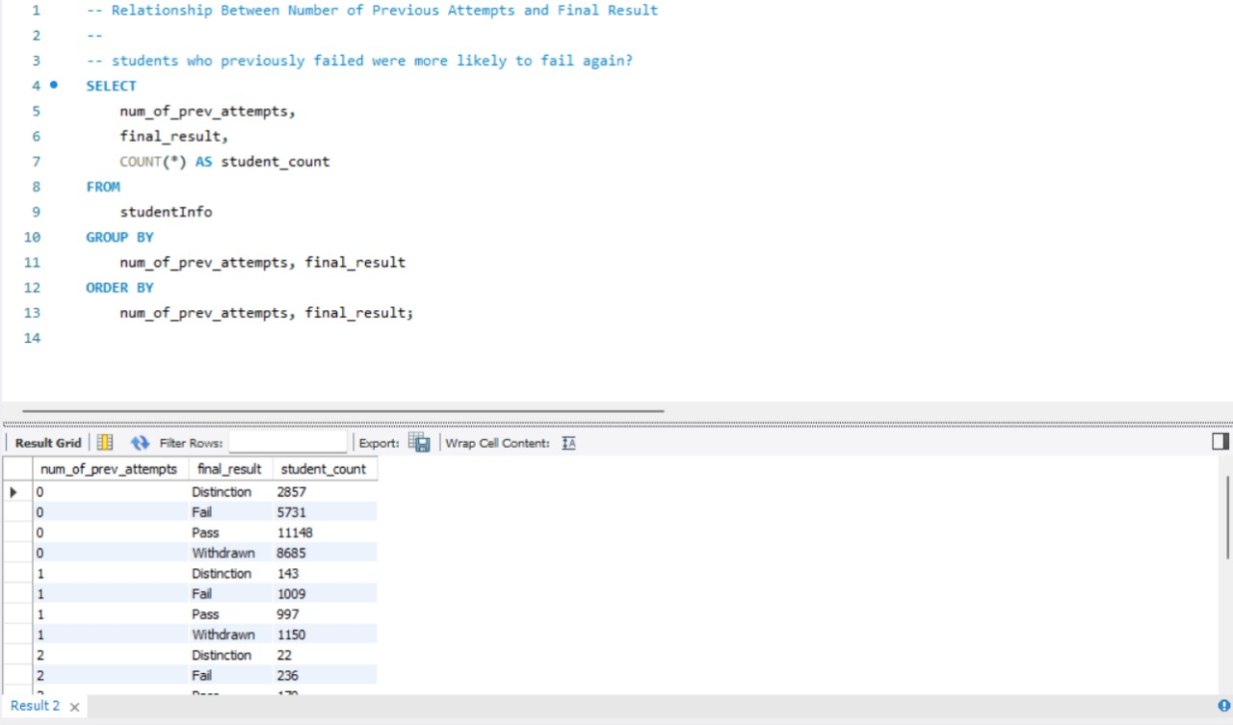

Slide 18
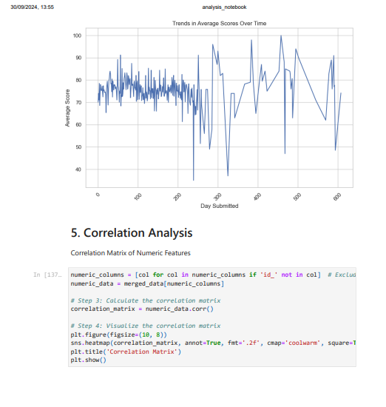
Data pre processing

Slide 19
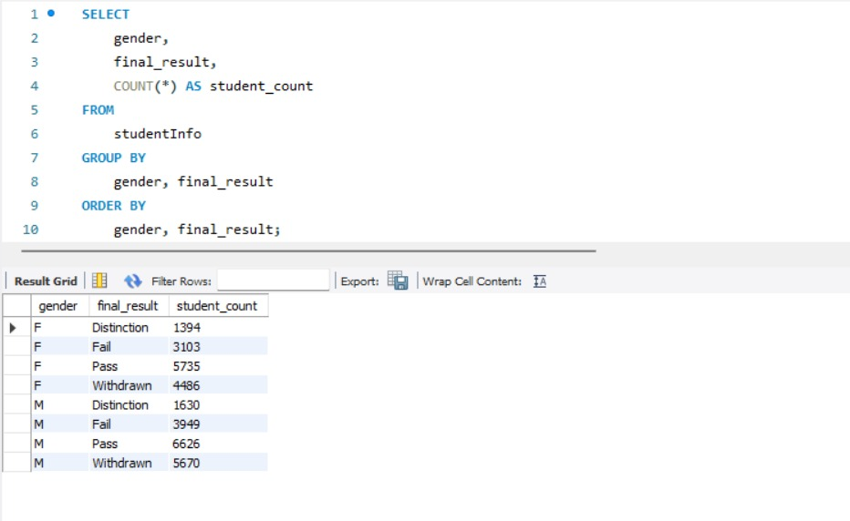

Slide 20
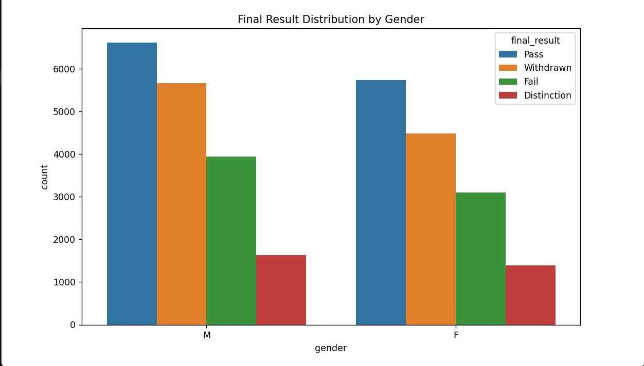
Data visualization

Slide 21
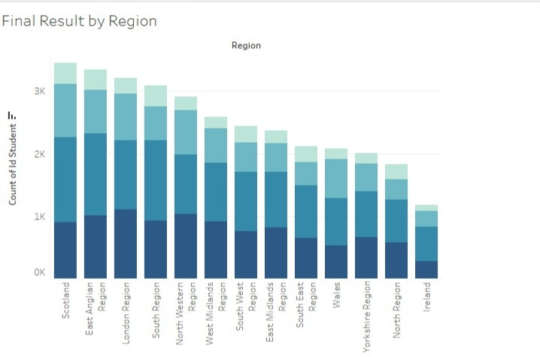
Region and final result

Slide 22
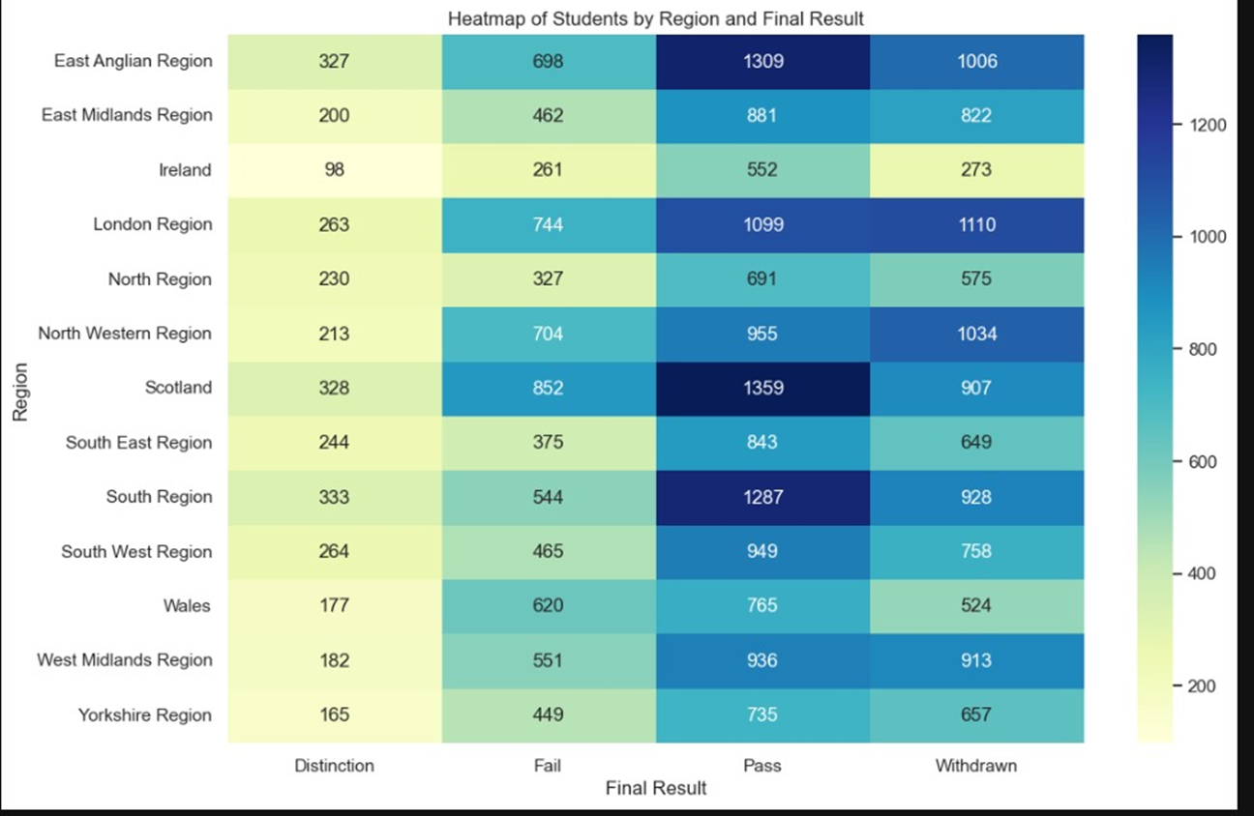

Slide 23
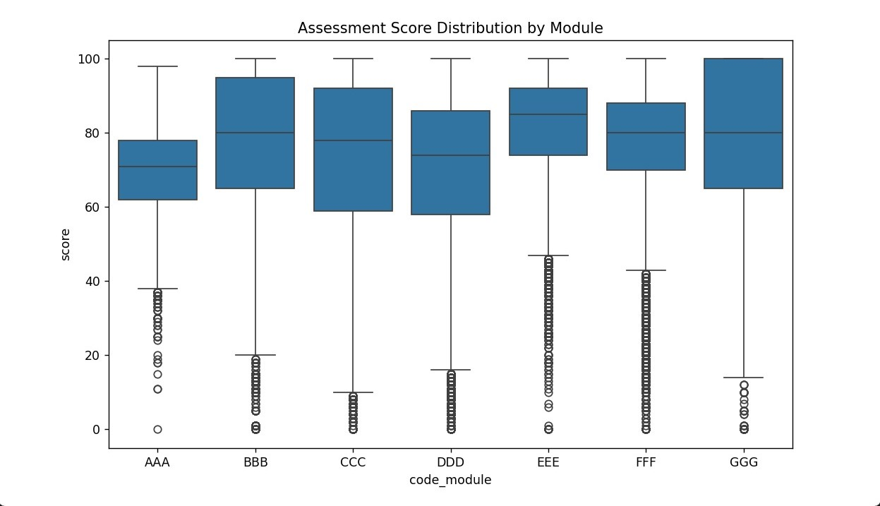


Slide 24
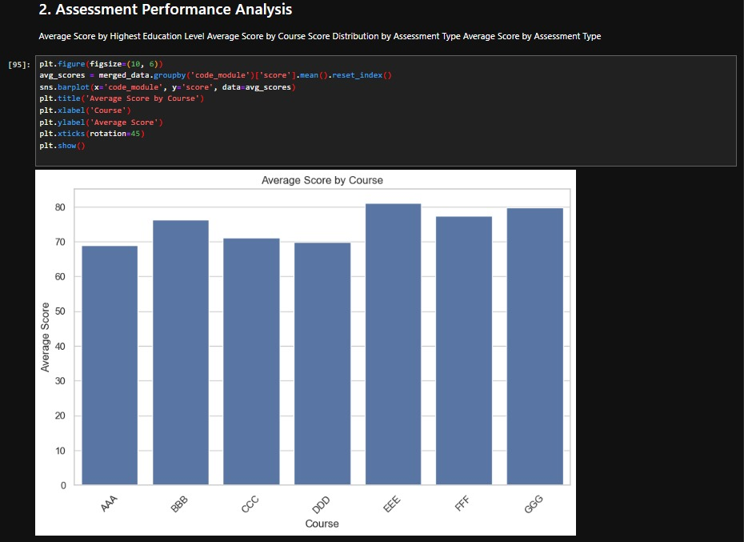

Slide 25
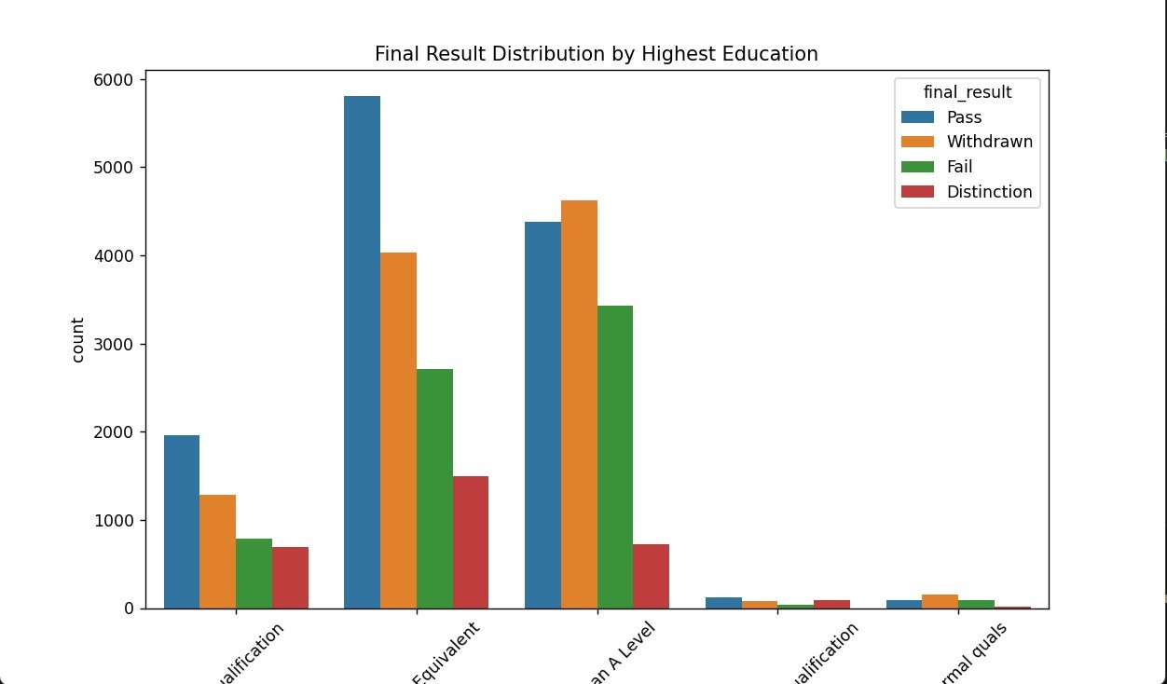

Slide 26
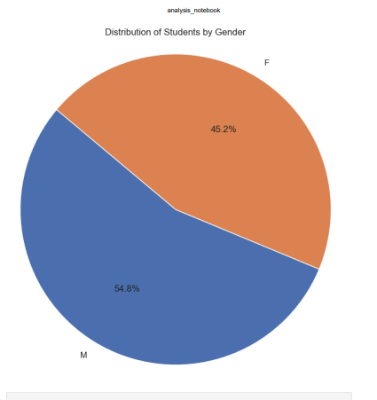
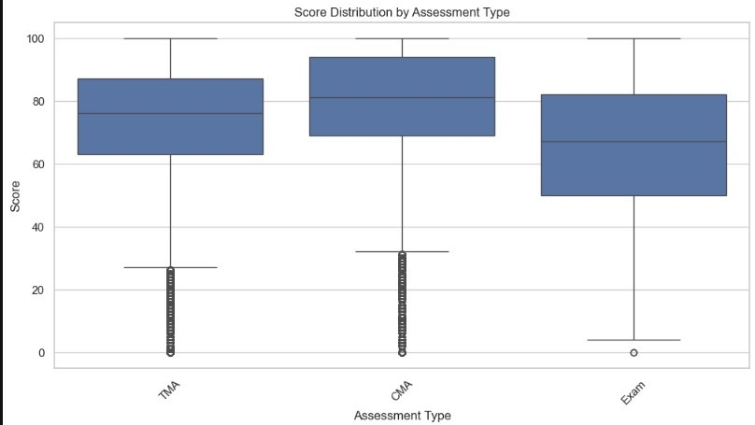

Slide 27
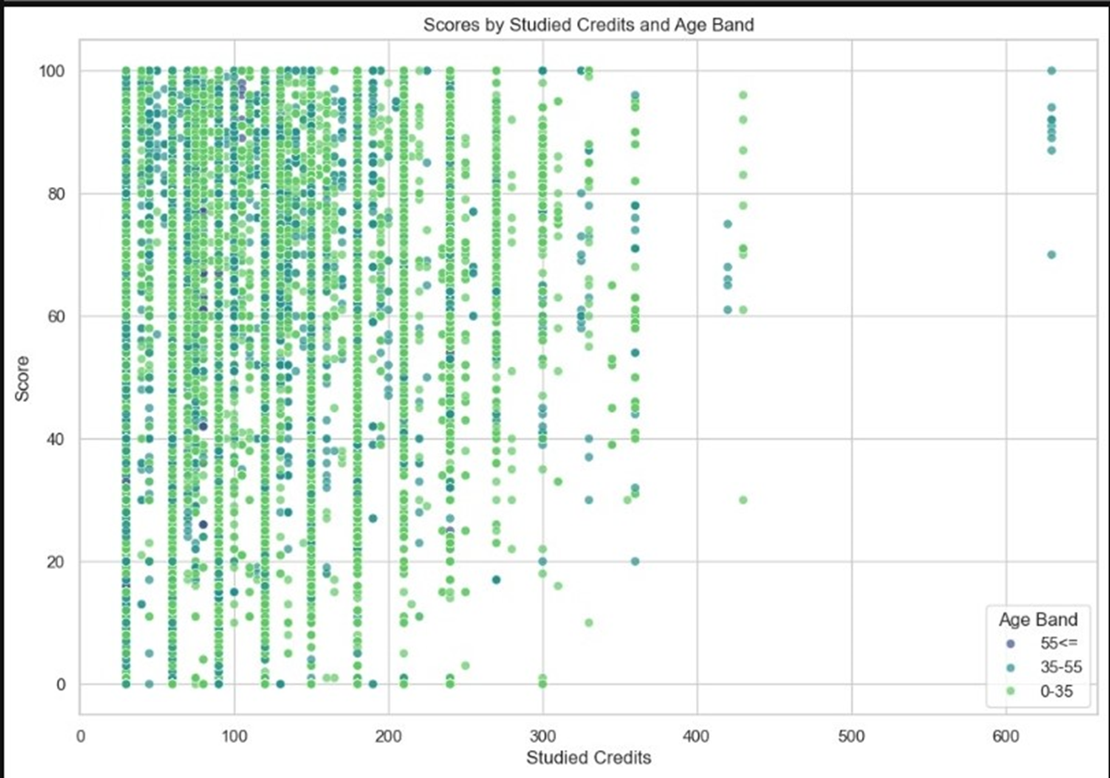

Slide 28
conclusion
Final result
Type of assessment
Age and gender
Vle activities
disability
Region
Registration day

Slide 29
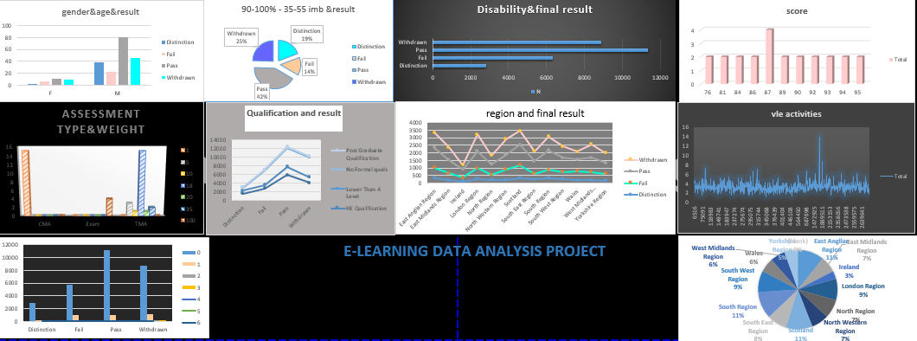

Slide 30
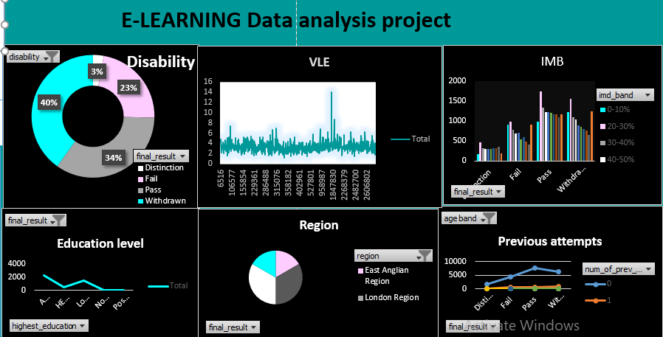

Slide 31


Slide 32



